Slide 1
Spring 2018 capstone: Indie game development
Andrew Clink – Computer Sciences Major – Software Engineering Track

Slide 2
Introduction

Slide 3
Before starting – The Rules of Game Development
1st Rule of Game Dev is apparently “Don’t talk about Game Dev”
2nd Rule of Game Dev: Games are a ‘Service’, not a ‘Product’
3rd Rule of Game Dev: Fun is hard to plan for
4th Rule of Game Dev: Fun is even harder to explain
5th Rule of Game Dev: The finished Game may look nothing like its original Idea or Prototype

Slide 4
Game Dev Steps
Get an Idea
Figure out the Game Loop
Make a Pitch
Write Down Mechanics and Story
Prototype Mechanics and Draft Story
Make the Game
Fix the Game
7.5) Balance the Game
8) Release the Game
9) Support the Game

Slide 5
What is the story? What are the mechanics?
Story
Mechanics
Setting
Characters
Plot
Motivations
Events
Genre
Move sets
Abilities
Key bindings
Challenges
Arenas
Puzzles

Slide 6
Give your ideas life
Who is the player?
Does the player have agency?
What are the story’s themes?
If there was a single message your story had to say, what is it?
What are the important conflicts in the story? Why are they important?
How does the player interact with the game world?
How does a player solve Challenges / Puzzles?
Does the game get more difficult? What is the metric for determining difficulty?
Can the player improve their avatar? To what extent can they be improved?
Is there more than one solution to challenges/arenas/puzzles? How many different solutions are there?

Slide 7
Two Biggest Questions
How is the player avatar special?
What is the singular defining mechanic of the game?

Slide 8
Planning development timeline (in abstract)
Prototype (test the Most Important Mechanic – aka the Gimmick)
Pre-Alpha (develop the MVP / Vertical Slice; Identify “Tech Debt”)
Alpha (MVP / Vertical Slice is complete; add basic features)
Beta (Expand on basic features with more complexity; do basic balance pass)
Gamma (Limited release; is what was just made actually fun? If not, change it!)
Release (Crucial, month-long period; hot fixes, patches, bug smashing)
Post-Release (Content Patches, Expansions, DLC)
Pre-Planning (The cycle begins anew…)

Slide 9
Whoosh – The Modern Air Combat Roguelike

Slide 10
What is Whoosh?
Story
Mechanics
Player is a pilot in a mercenary air force, hired by various nations and factions to provide Close Air Support, Combat Air Patrols, and Air Defense Interception.
Player will take missions to finance their air force, improving their relations with various factions in the process.
Make enough money, and the Player will be able to retire and pass on some of their winnings to the next playthrough attempt.
Player will use a variety of maneuvers and weapon systems to engage Bandits and Mission Objectives
Landing, Refit, Repair, Refueling
Player can upgrade Pilot and Airframe (or just buy a new Airframe)
Loot, Mission Rewards, Factions, etc.

Slide 11
Player Will fly a combat aircraft using Energy Management / Air Combat Maneuvering principles, not like a UFO
The Single Most Important Game Feature!

Slide 12
Proposed Feature List
Player Progression through equipment, leveling system
Meta-Progression through “Ace Records” and Post-Run Rewards
Multiple Factions to Gain (and Lose) Reputation
Dynamic Missions generated in Proc-Gen terrain
Player Faction – be your own boss/building manager/squadron commander!
R&D – make your own planes and weapons

Slide 13
Minimally Viable Product / Prototype
Player flies the plane
Bandits flies its plane
Player and the Bandit can shoot at each other with ‘Cannons’ and ‘Missiles’
Player and the Bandit start unaware of each other, and must use their ‘Radar’ to locate and track each other
Starting Distance: Player starts at edge of Map, Bandit starts somewhere outside the Radar of the Player
Win Condition: Player shoots down the Bandit
Lost Condition: Player gets shot down by the Bandit

Slide 14
Planning development timeline (in abstract)
Prototype (Get the MVP done)
Pre-Alpha (Map, Mission, Airframe, Weapons, Radar, Acquisition, AI)
Alpha (Advancement, Upgrading, Meta-Systems)
Beta (All Modules present; add Depth to Modules, Bug Fixing)
Gamma (Balance Passes, Continued Bug Fixing, Limited Release, Documentation)
Release (Hot Fixes, Patches)
Post-Release (More Planes, Weapons, Advancement Options)
Pre-Planning (Story Mode; Extended Campaigns, Multiplayer)

Slide 15
Ideas for Post Release (Whoosh EX)
More Random Campaign Options: fully random Factions/Nations, random Globe, random plane allocations, random F/N training programs
More Planes: Support Planes, Helicopters, VTOLs, Drones, Multi-crew
More Weapons: Cruise Missiles, sub-munitions, Lasers, and even crazier unrealistic weaponry
More Pilot Upgrades: Skills that override penalties completely, skills that offer special EWAR actions without the proper Radar, etc.
Story Mode: A fully fleshed out story with the roguelike penalties removed
Any other ideas that weren’t developed or thought up during initial development

Slide 16
Module creation – Shooting / ATA Combat
This is a practical demonstration of developing a module for Whoosh. We’re going to make a design document outlining the purpose of the module, it’s use cases, and some Pseudocode. Without further ado, let’s make a video game module!

Slide 17
Identify purpose of module
Shooting module allows an Actor to attempt to engage and destroy another actor
Actors may have different types of weapons that allow for different types of engagements
Basic implementation will be just the Cannon and the Missile systems
Advanced implementation may include Data-Link, SARH/ARH Missiles, Passive Missiles, Different types of Cannons, Cannon Pods, Rockets, Bombs, and even Decoys

Slide 18
Identify Requirements of Module
Each Actor needs to know what it has equipped
In this case, assume only a “Cannon” and a passive-targeting “Missile”
Each Actor needs to be able to swap weapon systems currently active
Each Actor needs to react to being engaged on by these weapon systems
Actors cannot fire the same weapon two turns in a row
Each weapon has a ‘cooldown period’ before it can be fired again
Missiles that are fired will spawn an Actor either to the left or right of the firing Actor; they will take their turn after all other Actors in the turn order

Slide 19
Identify conflicts and integrations with other established modules
Actors need to be able to defend themselves
Actors need to take damage
Actors need to know the finite amount of munitions it is allowed to expend
Actors need to be ‘splashed’ when they run out of damage to take
Actors need to know where to place the missile when fired

Slide 20
Test Cases – this works when…
If an Actor is using a Cannon on another Actor within the Optimal Range of said Actor, and said Actor is also within the Targeting FoV, then that Cannon will hit – damage is dealt based on the range of the cannon divided by the Cannon’s damage value
If an Actor launches a missile outside the minimum range of said missile, then the missile will ‘activate’ on the following turn
If a Missile ends its turn adjacent to the actor it is tracking, then the missile detonates at the end of it’s movement, dealing damage to the targeted Actor based on the damage of the Missile
If a Missile ends its turn on top of the Actor it is tracking, that Actor is considered destroyed and out of the fight
If an Actor is at 0 hp (in Whoosh, this called “Luck”) and receives damage from another source, that Actor is destroyed and removed from the fight

Slide 21
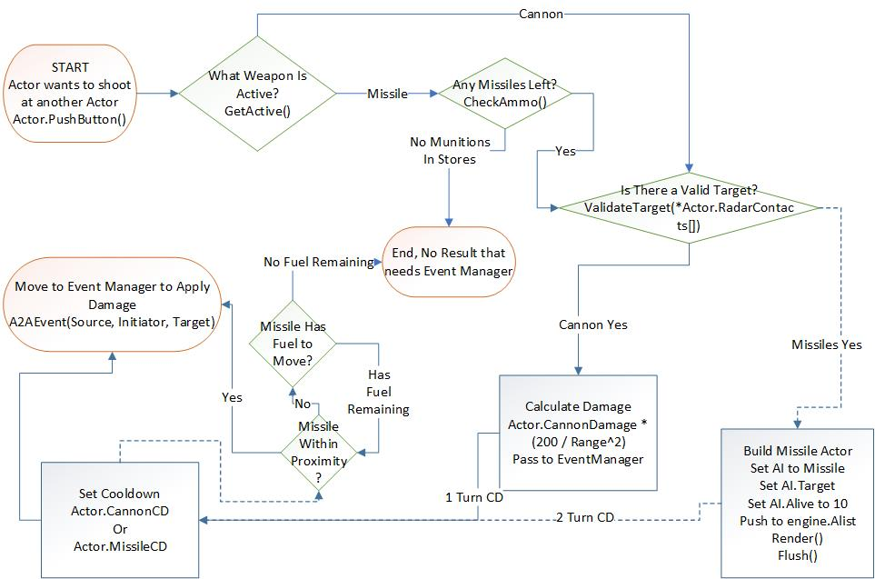
Pseudocode! – Steps to fire a weapon system

Slide 22
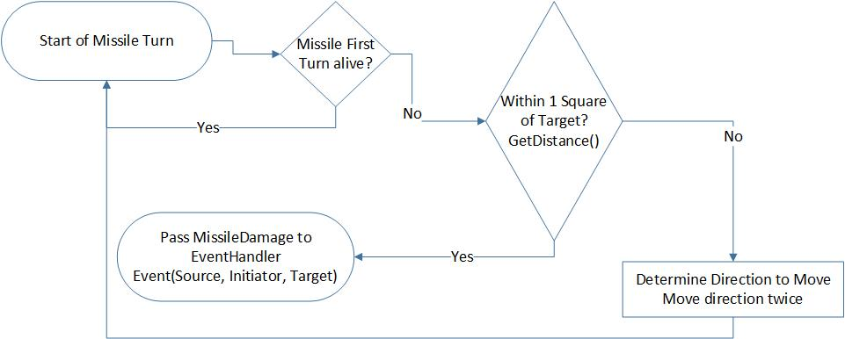
Pseudocode! – Missile Proximity and Targeting

Slide 23
Pseudocode! – Turn Order / Main Loop
while(Game Window is Open)
{
Wait For Keypress;
engine.player.update(keypress);
engine.flush();
Update Actions for Enemy Planes
engine.flush();
Update Actions for Missiles, if applicable
engine.flush();
Update Mission Actors, if applicable
engine.flush();
Update Environmental Actors, if applicable
engine.flush();
}

Slide 24
Conclusions

Slide 25
A Learning Experience
This project felt vindicating in a certain sense
For a “Put Up or Shut Up” moment, I was able to clearly demonstrate what it was I was trying to achieve from the get go
Learned many new coding techniques, and expanded on many other techniques learned across a curriculum of study
AI Decision Trees is now something I can talk about with actual experience, other than “Maybe they coded it that way”
I got a chance to experience not just making a video game, but the whole process from start to (relative) finish
I plan to come back to this during the summer and continue to work on it; it’ll make a great resume’ piece!
Found a new appreciation for Project/Time Management Tools
Trello, Workspace, OneNote, Slack

Slide 26
Changes to Make
Use a different Library/Engine
LibTCOD was written in the 98 C++ standard; open source projects can have sketchy update quality and timelines for these sorts of projects
Probably drop the Roguelike elements
Random and Procedural Generation is fine, but the perma-death and start from scratch aspects add next to nothing to this game as is
Smarter Prototypes
Break down Modules into smaller parts, then merge them into the codebase

Slide 27
Questions?

Slide 28
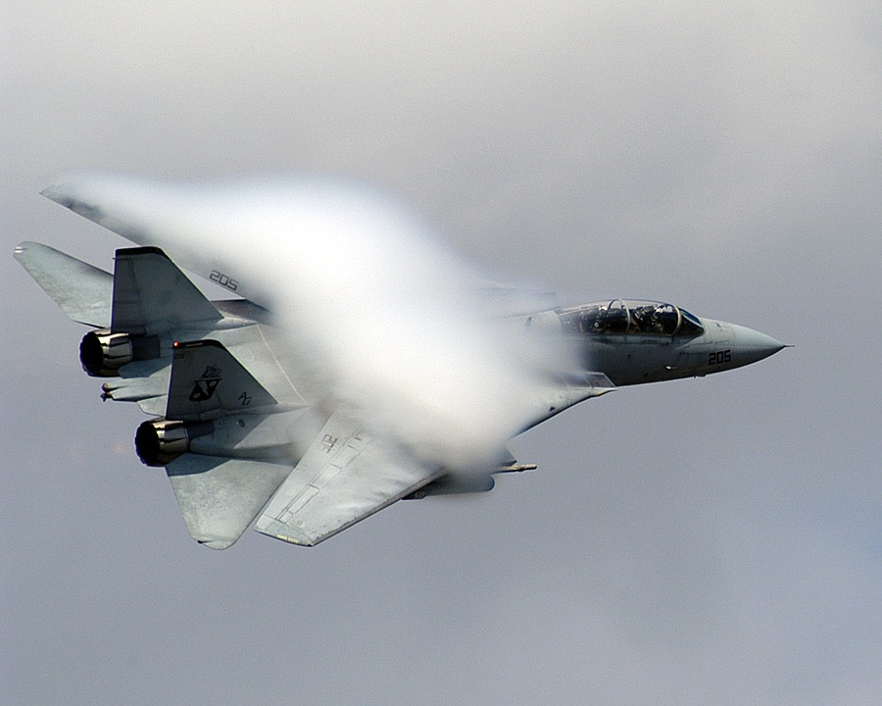
Thank you for your time!
Special Thanks:
Quintin and Ashley for the name "Whoosh"
Shantelle for the T-Shirt art
2018 Faculty and Seniors for their Support
The SARogueDev Discord user group for Advice
PicoArmor for the Diorama Miniatures
Clash Bowley and Flying Mouse Games for the Tabletop Rules
...and the continued support of Friends and Family!
Woooooooooooooooooooossssshhhhhhhhhhhhhhhh!!

